Slide 1
Data Science/ Engineering
Overview and Architecture Implications

Slide 2
What does Arch/ Req have to do with it?
This is Architecture / Requirements … what does that have to do with Data Science or Machine Learning?
  DS and ML are applications of software and technology
  Requirements and Architecture are how you go about creating applications
  You can’t create applications without understanding their purpose
    Context
    Domain
  We have covered many application ‘domains’, and given the prevalence (on ongoing growth) of Data Science and ML, it is important that anyone designing or architecting software understands these topics

Slide 3
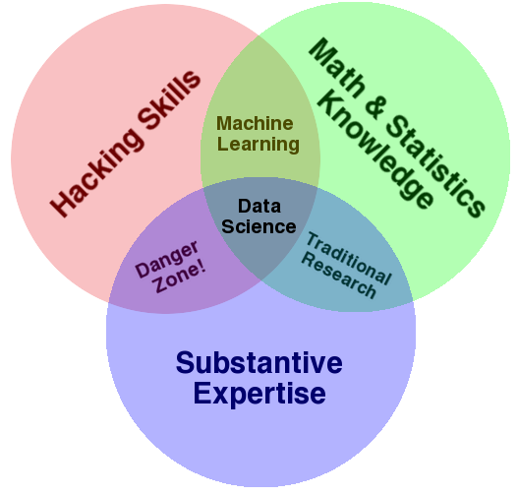
What is Data Science?
Find order, meaning, value from (unstructured data)
  2019 (indeed.com): 29% increase YOY in data science jobs
  Linkedin: gap in supply/ demand (150K gap)
BUT: Data w/o software and applications … is just data
Drew Conway: Dev skills + Math/ Stats + Domain Expertise = Data Science
The Data Science Venn Diagram — Drew Conway

Slide 4
Data Science Projects
It’s rare (and usually unwise) to have one person do it all on anything other than a small project
Multi-disciplinary team are usually pulled together
Roles/ Team
  Data Engineer: The SME in programming
  ML Specialist: Deep learning and algo
  Researchers: Domain specific specialist (biologist, doctors, physicists) with stats skills
  Analysts: SME in data DB, Visualization
  Business/ Project lead: Data+SW+Business skills

Slide 5
Why do we need data?
Insights
  Business: Competitive advantage
  i.e. BI (Business Intelligence)
Data sources:
  Social network data (graphs/ connections)
  Images (pictures)
  Streaming data (video)
  These all provide the ability to do analysis/ provide analytics

Slide 6
Types of analytics
Descriptive (Here is what is going on)
  Show plots of data. Humans can draw conclusions from the information shown
Predictive (If X occurs, then Y will occur, or here is the most likely outcome given the current information)
  Medical Treatment expected results
  Investment results
  Recommendation engines (we think you will like this)
  Every single poll in politics
  Health predictions (if your blood pressure keeps increasing at this rate …)
Prescriptive (Do X to achieve Y)
  As it says
Notes:
Regression is a common way to use understandable math/ data for predictive

Slide 7
Basic steps
Have to:
  Get data
  'Clean' data
    NOTE: 80% of project time spend on cleaning data
  Explore data (visualize, understand, experiment)
  Iterate to clean data again
  Model the data (can you abstract the data)
    Necessary to make predictions
    Validate the model (iterate)

Slide 8
The tools we use
  Python/ R: Modeling and data manipulation
  C/C++: Fast backend processing
  DBs: SQL
Math: Probability, regression, linear algebra, calculus
Which math to use to process data

Slide 9
AI vs. ML vs. Data Science vs Engineering
AI vs ML vs Data Science
ML: Learns over time; fixed algorithm
  Supervised Learning
    Specified input; Specified output (i.e. labelled data). SW figures out how to get from input to output by ingesting large amounts of data and working out the patterns to get from A to B
  Unsupervised Learning
    Massive amounts of data. SW finds pattens in the data. Self adjusting as more data is ingested
AI: Learns over time; algorithm adjusts on it's own over time e.g. Neural networks
  Discriminative AI: Predicts outcomes or categorizes based on historical data e.g. NLP/ Sentiment analysis …
  Generative AI: Creates new data (output) e.g. ChatGPT/ Gemini/ DALLE-2 …
DS: The data and SW under the hood for both
Data Engineering?
  Building all the tools and applications that use the data for use in Data Science

Slide 10
Raw Data vs Smart Data
ML and AI ingest data to provide smarter insights … but they need to learn
Training systems
Large input of data; labelled
  System self learns based on labels
    E.g. "Is this a street light"? (Common captcha)
  Neural network starts with basic image (input) and starts comparing to labelled output or expected output
    Internally it develops a set of connections based on input, analysis (from internal algorithms) and expected output. And the internal algorithms keep changing over time and as more and more data comes in)

Slide 11
Arch impacts
  How to organize data
  Services or new code needed to cleanse and manage the data
    What ‘type’ of data? Image? Text? ASCII or multi-byte Text?
    How much Data?
    What throughput is needed?
    Parallel or serial processing?
  How to select tools/ impacts on the application
    C/ C++/ Java/ C#/ Python
  Efficiency in algorithms
  Distributed system or single system?
  Communications type and synchronization needs?
  Ability to modify algorithms easily
  Swap in different modules; Integrate different technologies
  Ways to present data
  Automation

Slide 12
Data Science/ Architecture … not so different
Data Science /ML
Architecture
Collect data
Explore data
Prepare data
Model
Evaluate
Collect requirements
Review/ refine requirements
Generate options for architecture
Model or prototype options
Evaluate

Slide 13
Data Cleaning
Data anomalies are common in Data Science
Often, data is imported from multiple sources – and over time (so things change). Issues include:
Missing data
Incomplete Data
Duplicate data
Incorrectly formatted data
Inconsistent data
Outlier data
Sometimes it just that the data is not in a format or structure that makes it easy to analyse!
Data Engineering will use tools to uncover issues and correct them

Slide 14
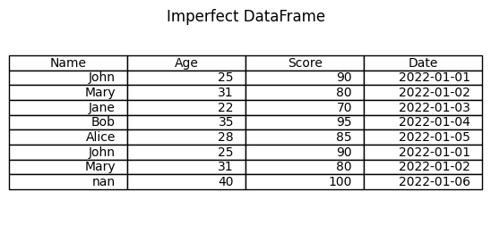
Example
Duplicates? (John)
Date Format? (Time? MM/DD or DD/MM)
Outliers? (100)
Missing? (nan = Nan or NaN?)

Slide 15
Tools
numpy
pandas
matplotlib
General tools
regex
scripts

Slide 16
Analysis
While descriptive analysis is a common starting point (using charts to show the nature of the data), a more advanced approach is predictive analysis
Descriptive: What is
Predictive: What might be
We’ll consider a basic predictive mechanism called ‘regression’
Think back to high school math ☺

Slide 17
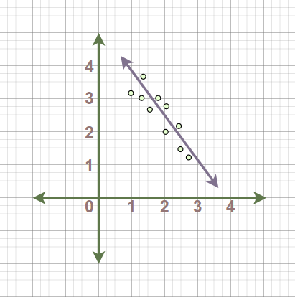
Linear regression
You may also recognize this as ‘line of best fit’
Essentially a line that minimizes variance between each data point
By establishing a regression line (best fit), any new data point (x) can have a predicted outcome (y)
X: Independent Variable
Y: Dependent Variable
matplotlib, sklearn are popular python libraries to help

